Slide 1
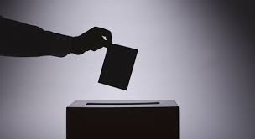
Comenius 2015 - Spain
UK Presentation
Notes:
Hello and welcome to the UK’s presentation on European democracy.
We have been looking at the role of the European Parliament and finding out about our MEP’s. But firstly, let me tell you what’s been happening since we last met in Berlin.

Slide 2
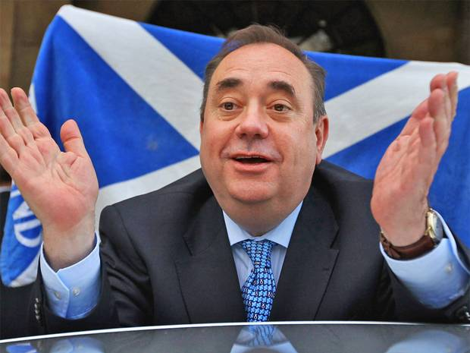
This is what’s been happening in the UK:
Just to remind you, the last time we saw you there had just been a vote to whether Scotland should be an independent country.
The results were 55.3% voting against and 44.7% voting in favour.
Alex Salmond the leader of
the Scottish Nationalist Party
resigned after the election and
they now have a new leader.
Notes:
Just to remind you, the last time we saw you there had just been a vote as to whether Scotland should be an independent country.
The results were 2,001,926 (55.3%) voting against independence and 1,617,989 (44.7%) voting in favour so the UK is still united and the Queen was particularly pleased!
Alex Salmond the leader of the Scottish Nationalist Party resigned after the election and they now have a new leader.

Slide 3
Upcoming General Election
The next United Kingdom general election is this year.
The election will be held on the 7th May and we are not expecting that one political party will gain an overall majority.
This means we are likely to have another coalition.
Lots of people think we should change the ‘first past the post’ system to proportional representation. We will have to wait and see…
Notes:
The upcoming United Kingdom general election is to be held in 2015, to elect the 56th Parliament of the United Kingdom
The election will be held on the 7th May and we are expecting that one political party will not gain an overall majority.
This means we are likely to have another coalition. Lots of people think we should change the ‘first past the post’ system to proportional representation. We will have to wait and see.

Slide 4
UKYP
Our school, St James, has registered as a polling station for the UK Youth Parliament.
Every one in the school will get to vote.
Their campaign for 2015 is ‘A living wage for all’
Notes:
Our school, St James, has registered as a polling station for the UK Youth Parliament.
Every one in the school will get to vote.
Their campaign for 2015 is ‘A living wage for all’
This is to ensure a higher minimum wage to guarantee a better standard of living for everyone.

Slide 5
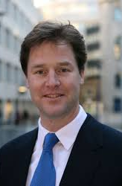
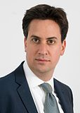
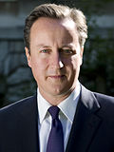
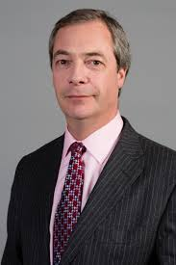
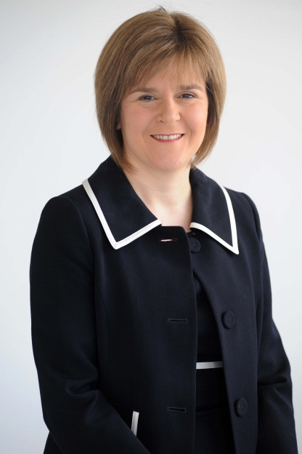
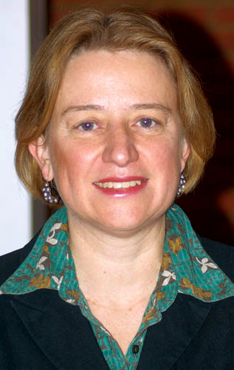
Here are the main party leaders in our general election:
Do you recognise any of them or know which political party they represent?
Notes:
1) Nick Clegg, Lib Dem
2) Ed Milliband, Labour
3) David Cameron, conservative
4) Nigel Fararge, UKIP ( Uk Independence Party)
5) Nicola sturgeon, SNP (scottish Nationalist Party) her favourite TV programme is Borgen
6) Natalie Bennett, Green Party

Slide 6
EUROPE - WHAT DOES IT MEAN TO US?

Slide 7
EURO MP’S
To start off with we asked ourselves whether we knew who the Euro MEP’s were for the South West of the UK. Not one of the students knew any and not even the teachers or parents knew which meant that we had to investigate harder. This is despite the fact that there was an election last year.

Slide 8
SOUTH WEST MEP’S
Due to our lack of knowledge about the South West MEP’s we researched them in detail. We found that there are 6 Euro MEP’s for the South West: 2 UKIP (UK Independence Party), 2 Conservative, 1 Labour and 1 Green. They have absolutely nothing in common! Here is a map of how the UK is divided.

Slide 10
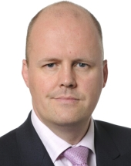
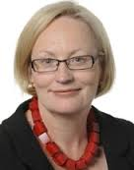
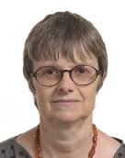
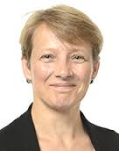
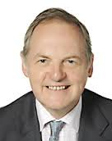
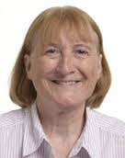
Ashley Fox
Conservative MEP
Julie Girling
Conservative MEP
Molly Scott Cato
Green MEP
Clare Moody
Labour MEP
William the Earl of Dartmouth
UKIP MEP
Julia Reid
UKIP MEP

Slide 11
CONTACTING THEM
We e-mailed them asking them if they were willing to answer some questions about the EU and their role in the parliament. They all answered except for the two UKIP MEP’s so we wrote to them again but still no reply; we felt this was disappointing as we wanted to have a balanced view on the subject. We later found out that they take money funded by our taxes and just stay at home rather than go to Brussels and Strasbourg. We will come back to them later!

Slide 12
Visit by our Euro MP

Slide 13
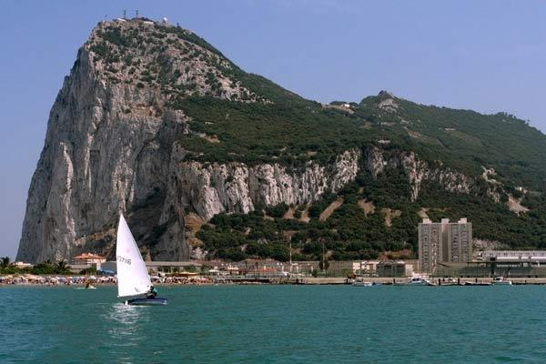
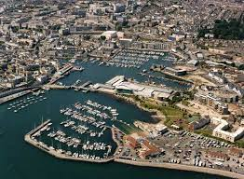
CLARE MOODY – LABOUR MEP
On Friday 16th January 2015 the Labour MEP for the South West, Clare Moody, paid us a visit. It was an exciting and interesting talk we had with her and we even found out that she represents Gibraltar as an MEP as this is included in the constituency of the South West. This is due to the naval links between Plymouth and Gibraltar.

Slide 14
How many replied?
Julie Girling, Ashley Fox and Molly Scott-Cato all agreed on the following aspects:
In the European parliament every day is different.
The European parliament and its politics is about compromise.

Slide 15
Britain – in or out?
The two Conservatives and the Green MEP all agreed that there should be a referendum as the EU has changed so dramatically since the UK first joined in 1973.

Slide 16
The UK’s relationship with Europe

Slide 17
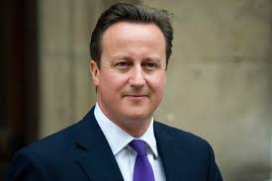
David Cameron promised the UK that if the Conservatives win the General Election in May this year he will hold a Referendum to decide whether Britain stays in the European Union or leaves.

Slide 18
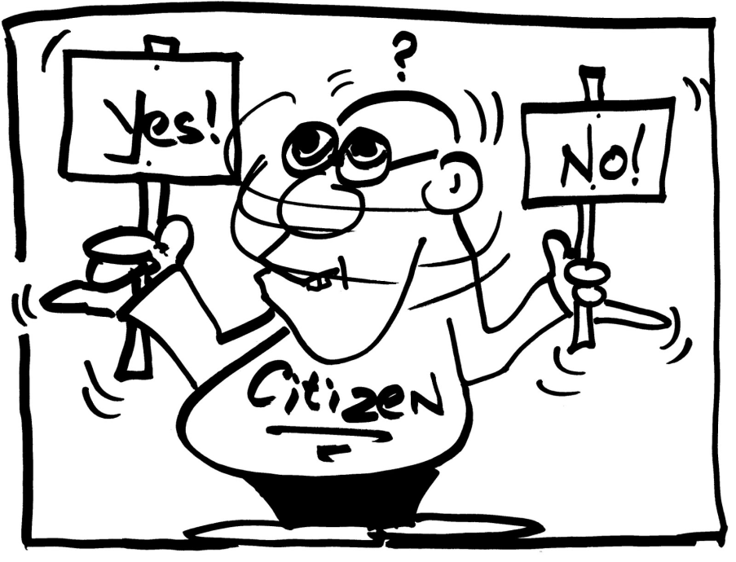
We held a referendum in our school to see whether the students and the staff think that it will be a good idea to leave the European Union.

Slide 19
Advantages Employment opportunities. The international trade markets keeps prices lower.

Slide 20
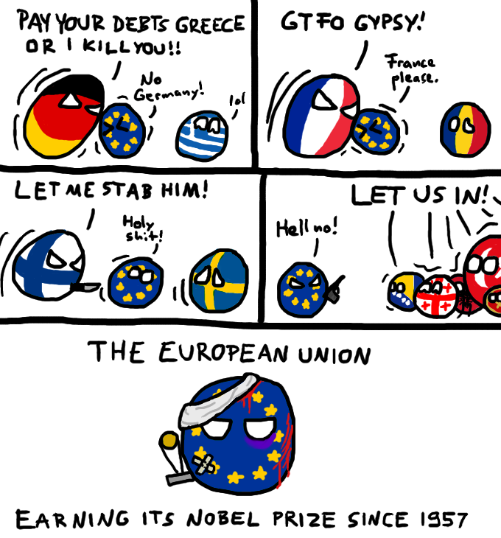
By working together we have more power.
Member states are less likely to go to war with one another.

Slide 21
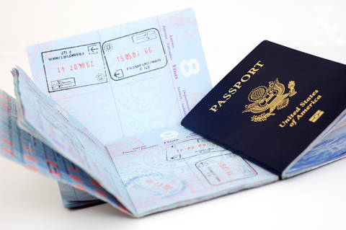
Citizens in any of the 28 member states have freedom to move, travel, and live anywhere in the EU without a visa
Being in the EU helps deprived regions

Slide 22
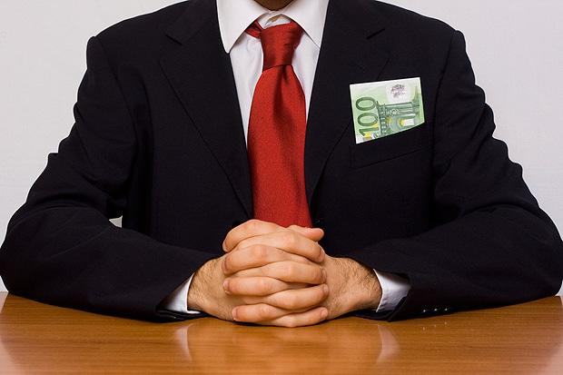
Disadvantages The EU costs money to run. The system which other countries use is collapsing.

Slide 23
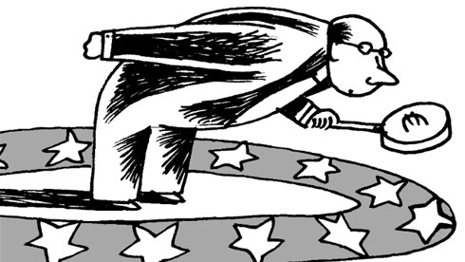
Member states have less control over how many EU citizens live and work in their country.
Member states aren’t free to act alone in some situations.

Slide 25
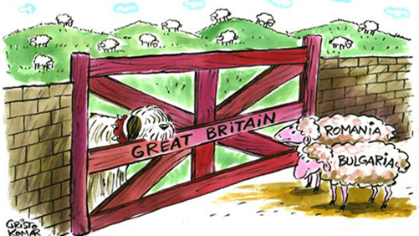
Immigration
Immigration is a very big political argument in the British parliament at the current time as there are a great number of immigrants coming into the UK from both inside and outside the EU.

Slide 26
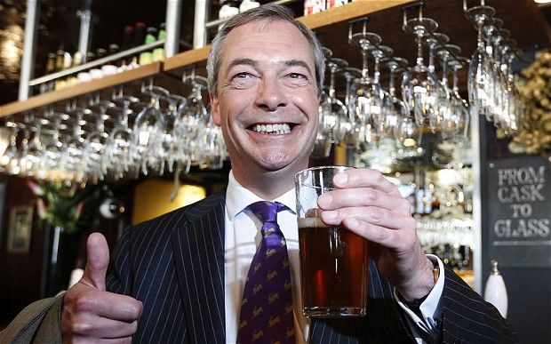
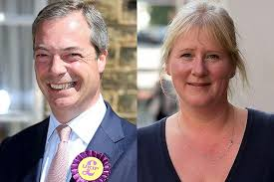
UKIP (United Kingdom Independence Party)
Notes:
UKIP has one member of parliament(as one converted to Conservative), three representatives in the house of lords and twenty four members of the European parliament

Slide 27
The future
General election in May
Will the UK continue to be in Europe?
Thank you for listening to our presentation.

